Slide 1
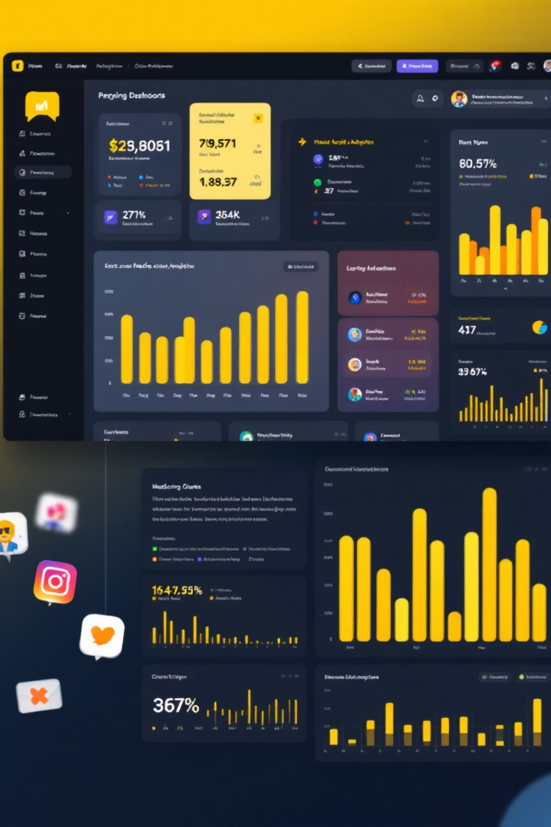
Instagram Performance & Growth Analysis
This project analyzes social media engagement and community growth across multiple brand accounts using a dataset of 29,999 records. Our objective is to identify factors driving follower conversion and evaluate performance across 10 diverse content categories.

Slide 2

Project Overview & Dataset Summary
Project Objective
Dataset Details
Identify factors driving follower conversion (e.g., caption length, hashtag density, media type) and evaluate performance across 10 content categories.
29,999 records with 17 features, including post metadata, technical factors, discovery metrics, engagement behavior, and growth metrics.
Data Quality
Zero missing values, standardized formats, and 100% unique post IDs ensure high analytical accuracy.

Slide 3

Data Preparation & Feature Engineering
01
02
Environment Setup
Data Ingestion
Imported Pandas and NumPy for data manipulation and statistical analysis.
Loaded 29,999 records from a CSV, logging post performance across multiple niches.
03
04
Cleaning & Validation
Feature Engineering
Standardized column names, validated data types, and ensured data consistency.
Engineered engagement_to_reach_ratio to measure content efficiency and converted upload_date for time-series analysis.

Slide 4


Key Exploratory Analysis Findings
Growth Drivers
Hashtags count and shares strongly correlate with followers gained.
Media Performance
Videos and Reels show higher engagement than photos, favoring dynamic content.
High-Impact Categories
Beauty and Photography have highest engagement; Technology needs strategic hashtags.
Conversion Gap
High reach doesn't always mean high followers gained, indicating a need for stronger calls-to-action.

Slide 5
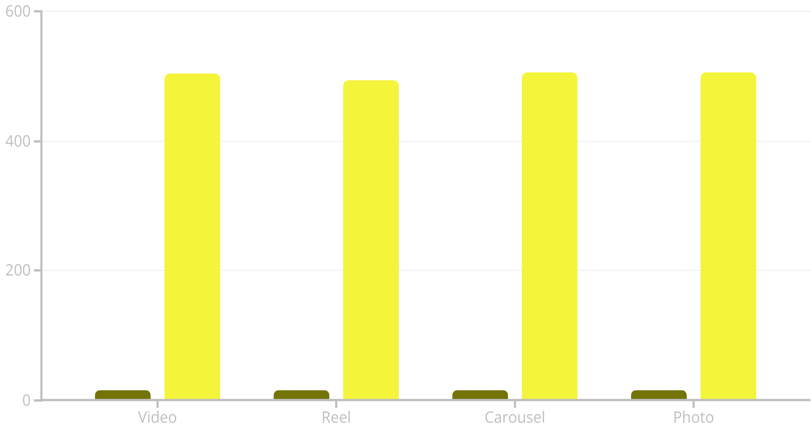
SQL Analysis: Media Type Efficiency
We analyzed media types to identify which format is most efficient at converting reach into followers.
Avg Engagement Rate
Avg Followers Gained
Videos and Reels consistently show higher engagement rates, indicating their effectiveness in follower conversion.

Slide 6
SQL Analysis: Engagement & Retention
Identifying high-performing niches and "High-Risk" segments where reach is high but engagement is failing to retain interest.
Comedy
2950
1031709
14.40
Moderate
Fitness
3004
1007764
13.95
Moderate
Beauty
2953
997565
15.66
Moderate
Fashion
3034
995999
14.52
Moderate
Technology
3025
994956
13.93
Moderate
Most categories show moderate retention, but deeper analysis is needed for "High-Risk" segments.

Slide 7
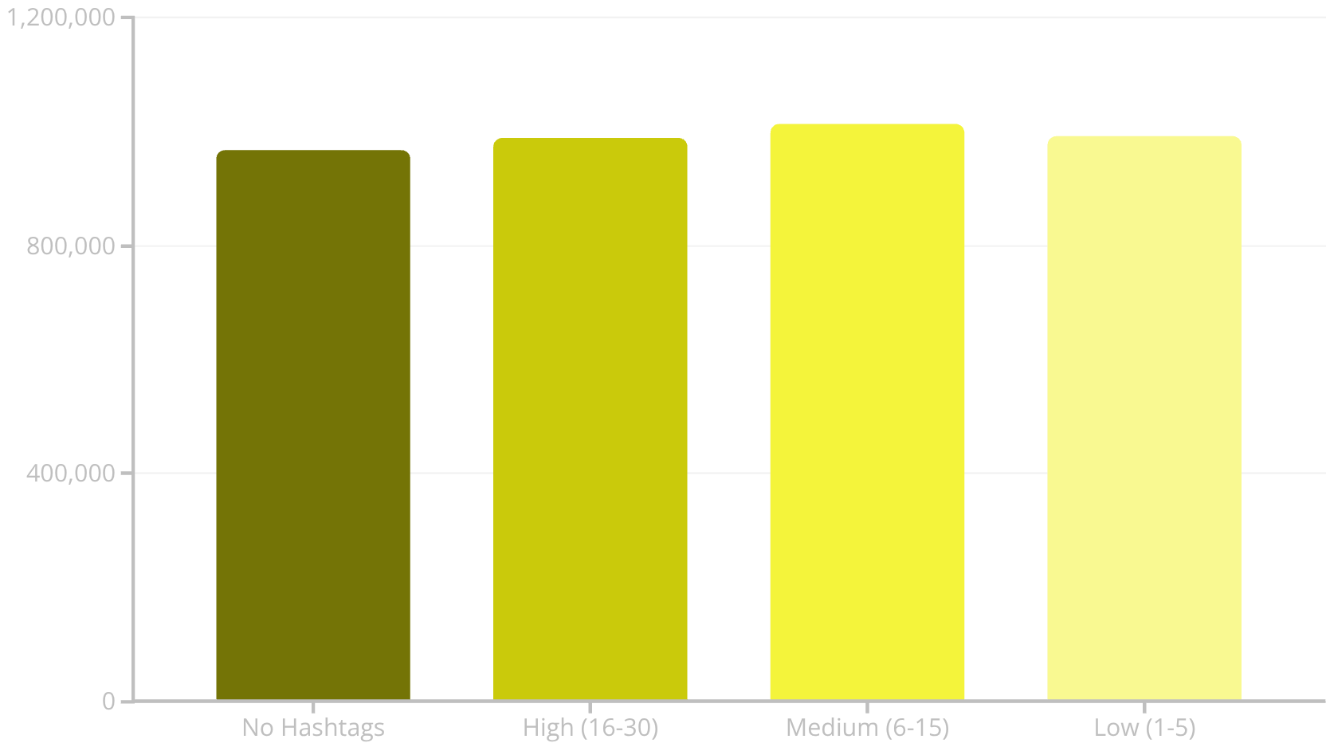
SQL Analysis: Shares vs. Saves & Hashtag Sweet Spot
Follower Acquisition
Hashtag Optimization
Testing if "Shares" or "Saves" are more strongly linked to new follower acquisition.
Identifying the "sweet spot" for hashtag counts to maximize reach without appearing spammy.
Low Shares, High Saves
Avg. Followers Gained: 504
High Shares, Low Saves
Avg. Followers Gained: 502
High Saves correlate slightly better with follower acquisition. Medium hashtag density (6-15) yields the highest average reach.

Slide 8
SQL Analysis: Discovery Channels & Caption Length
Most Engaged Audience
Optimal Caption Length
Determining which discovery channel provides the most "sticky" or engaged audience.
Providing actionable creative guidelines for content creators on the optimal caption length.
Profile
1264700
14.32
511
1
Home Feed
1245265
14.71
503
Explore
1229493
14.80
503
Long (>150 char)
Avg. Engagement: 14.48
2
Short (<50 char)
Avg. Engagement: 13.91
3
Medium (50-150 char)
Avg. Engagement: 13.44
Profile and Explore traffic sources yield high engagement. Long captions show slightly better engagement, but brevity is key for audience retention.

Slide 9
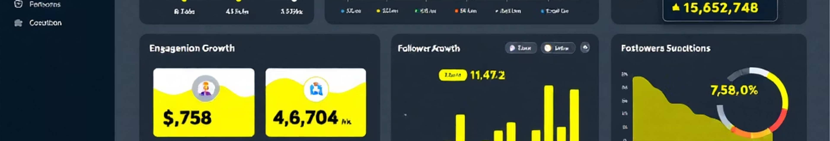
Power BI Dashboard: Visualizing Performance
The Power BI dashboard provides a comprehensive overview of Instagram performance, with key metrics and interactive visualizations.
KPI Header
Retention Matrix
Total Reach: 30bn, Avg Engagement Rate: 14.42, Followers Gained: 15M.
Heatmap flagging "High Risk" segments (engagement < 10%).
Discovery Funnel
Technical Sweet Spots
Maps traffic source to audience engagement.
Charts for optimal hashtags (6-15) and caption length vs. engagement.

Slide 10
Business Recommendations for Growth
Format Pivot
Prioritize Videos and Reels for higher "stickiness" and follower conversion.
Hashtag Optimization
Adhere to a strict 6–15 hashtag limit for maximum reach.
Caption Brevity
Limit captions to under 150 characters to maintain audience attention.
Focus on Shareability
Shift KPI from "Likes" to "Saves" and "Shares" for stronger account growth.
Targeted Intervention
Use the Retention Risk Matrix to optimize "High Risk" categories like Technology.

